Slide 1
Test Plan Test Log Evaluation

Slide 2
Design document
Previously we have looked at
Storyboards

Slide 3
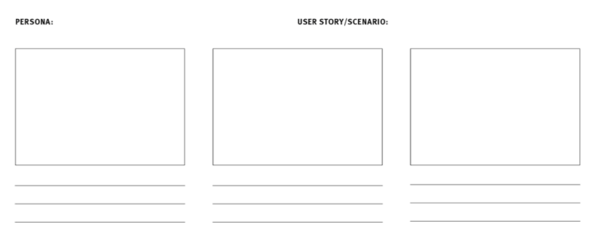
Storyboards – an overview
Communicate the story through images
Scenario
Visuals
Captions
Persona -> user story

Slide 4
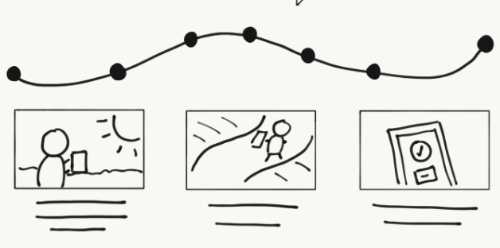
Storyboards
An example:
James, a mechanic
Wants to enter MOT details
Into the database
Then order parts needed to fix car

Slide 5
Input-process-output chart (ipo chart)
The IPO chart shows:
What data items are input
What processing takes place on the data
What information will be the end result – the output.
High level, structured thinking about the problem

Slide 6
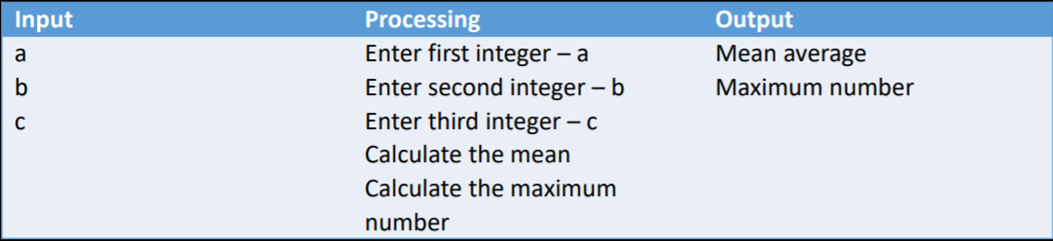
The output is first completed
The input is second
Processing last
Sounds odd, but think about planning a holiday:
First you decide where you want to go (output)
Second you plan the method of how to travel, what to take, etc. (input).
Lastly plan the route and logistics (processing)

Slide 7
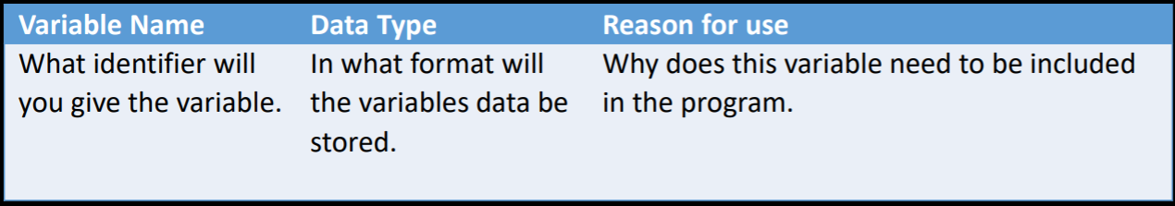
Data dictionary

Slide 8
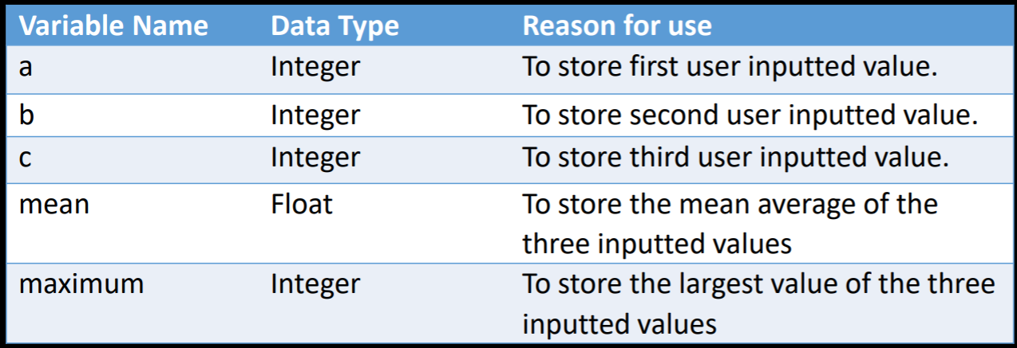
Data Dictionary (example)

Slide 9
Algorithm Representation
There are two ways to represent algorithms:
Flowchart – graphical
Pseudocode – textual

Slide 10
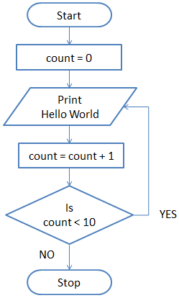

Slide 11
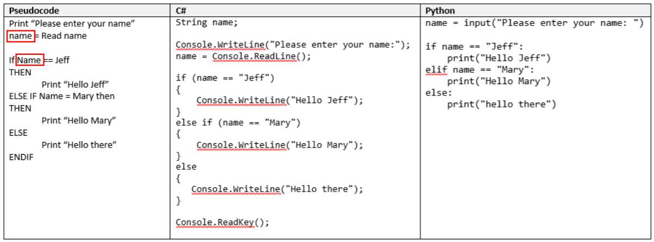
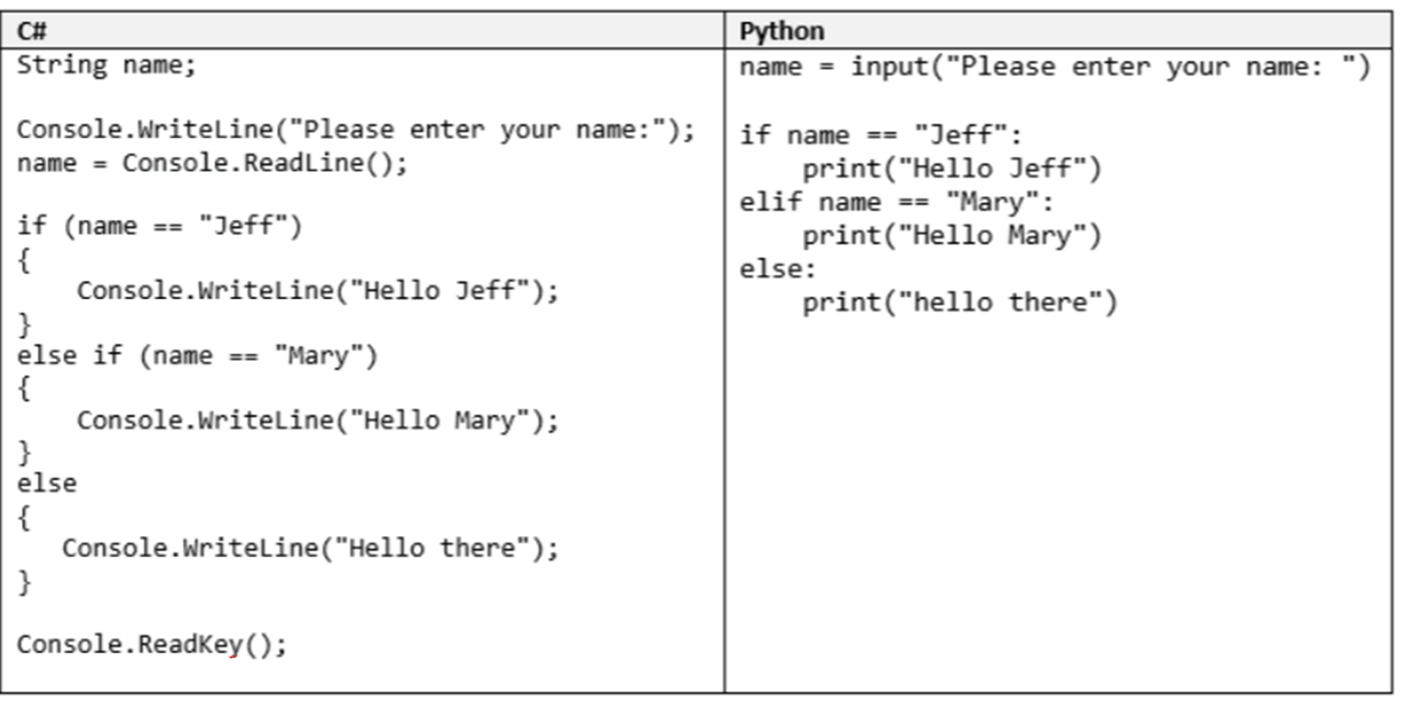
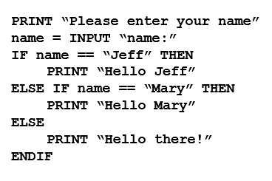
Pseudocode Example
The logic of a program in a non-language specific format
(language agnostic)

Slide 12
Write the software
Lots of time and effort
Lots of cups of tea

Slide 13
Why test software?
When you purchase a product from a shop, you expect it works as it should.
You expect it to have been fully tested prior to release.
The product should be fit for purpose
The same should be true of software

Slide 14

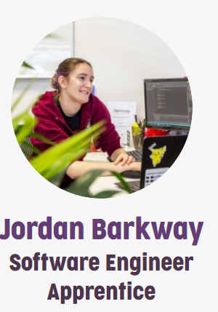
Commercial programs
Once a software product has been designed and developed…
…it must be fully tested to ensure that it does what it is supposed to do.
There is a whole profession/career based around being a software tester.

Slide 15
Testing for this module
The testing requirements for this project are quite straightforward.
We will be looking at basic specification testing –
Does the program perform the job(s) that was laid out in the specification?

Slide 16

Specification (requirements) testing
When faced with a client brief, a set of user requirements (or specification) must be produced.
In the previous lectures we looked at a problem that involved creating a castle in Minecraft
Remind me – what was the specification?

Slide 17
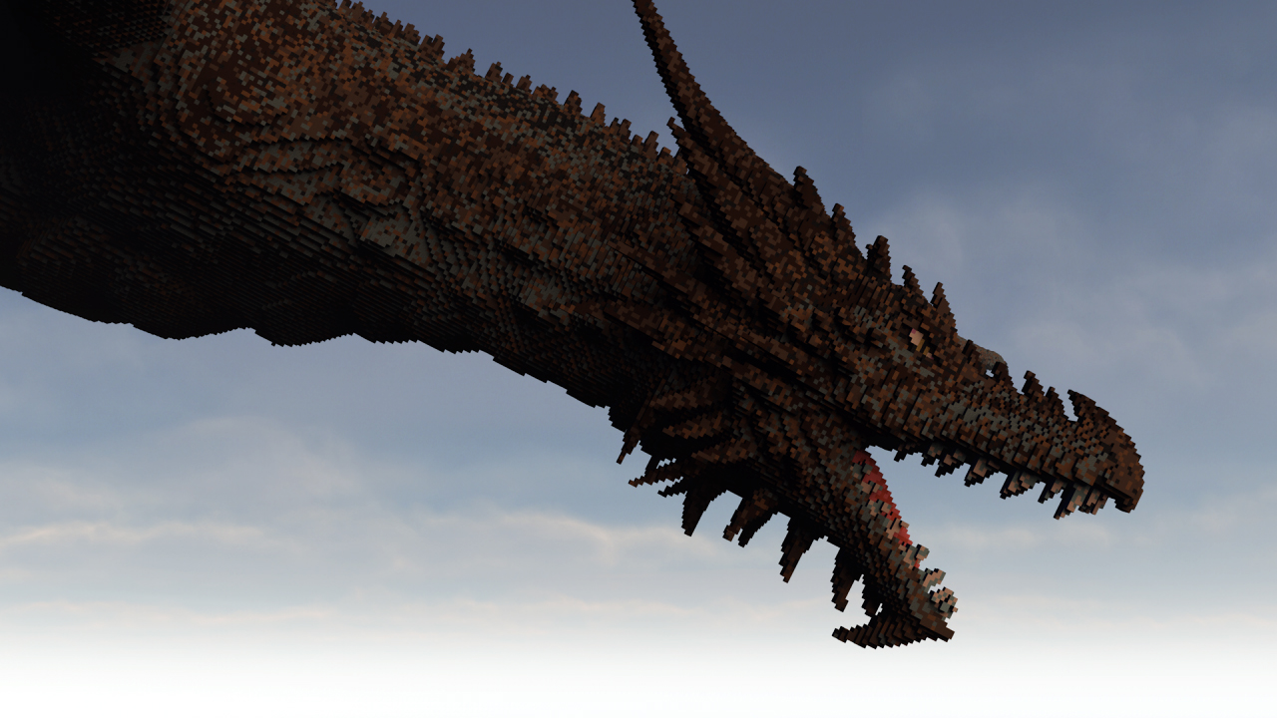
Uther’s requirements (Specification)
Castle
Width and depth as parameters
Must look, like, really cool and super sick, dude
It should be LGBTQIA+ friendly
Have a salad bar for big salads (Uther is a vegetarian (thank god))
Notes:
Lesbian, Gay, Bi, Trans (non-binary / androgenous), Queer, Intersex, Ally/Asexual, + (everyone else)

Slide 18
Requirements testing
Once you have created a list of requirements (the specification)…
…you can design and develop a program suitable of satisfying each requirement
Once the program has been developed…
…you can create a set of specification tests
These tests make up a testing plan…

Slide 19
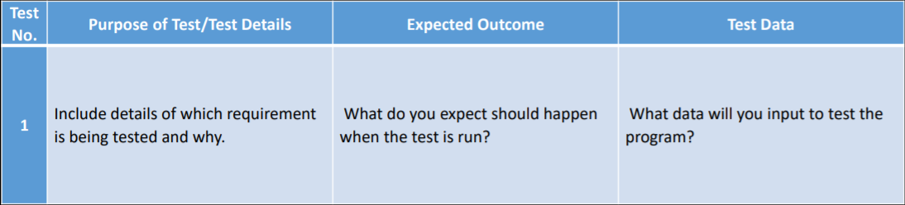
Testing plan (layout)

Slide 20
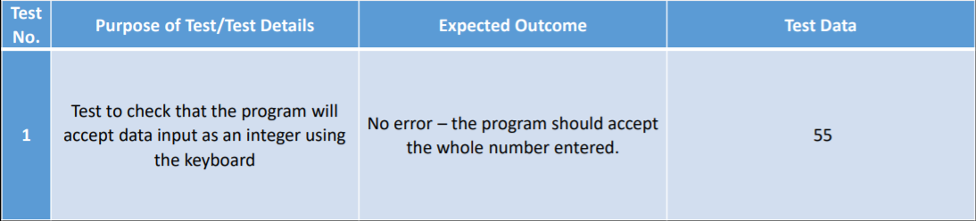
example

Slide 21
Carrying out the test plan
Once a thorough testing plan has been developed…
…every test must be performed.
For each test you need to document – with evidence – the actual outcome by completing a test log…

Slide 22
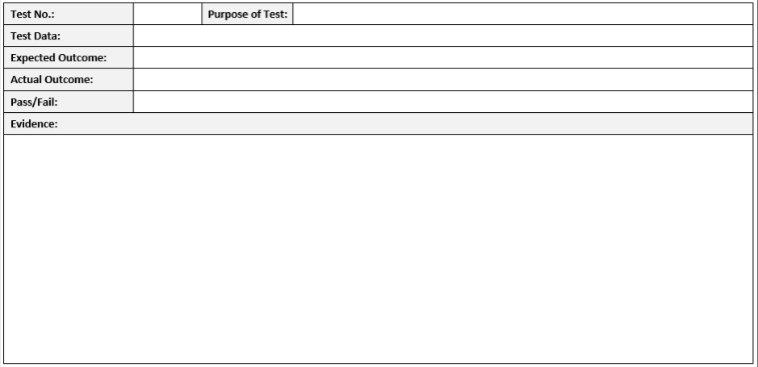
Test log

Slide 23
Test log
Pass in green
Fail in red

Slide 24
Summary of testing
Once all tests have been completed you should summarise your findings.
Then complete a revision log.
The revision log should list any changes that need to be made to fix any failed test
You must then make the changes and re-run the test.
Evidence of the re-run test should be recorded in a log to show the problem has been fixed.

